Slide 1


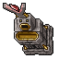
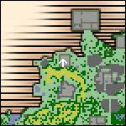
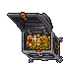
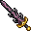
Alkurius OT
8.6
Cliente
8.6
TFS
Map
1.3
8.6
Nekiro
downgraded
forgottenserver 1.3
Source: Otland
Quest
8.6
Items
8.6

Slide 2
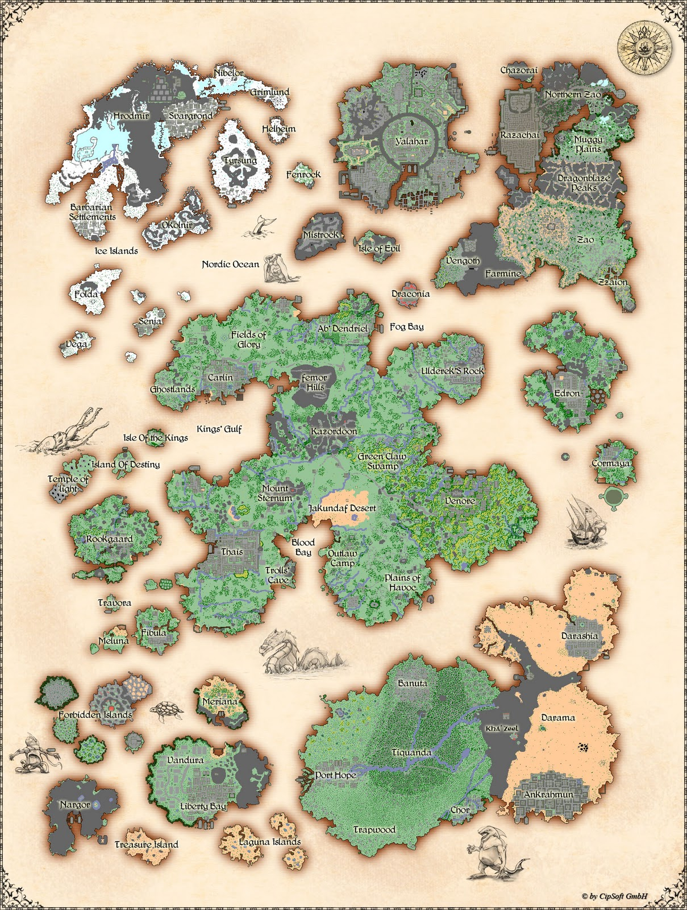
The map is versión
8.6
Rookgaard
Thais
Carlin
Kazordoon
Ab'Dendriel
Edron
Darashia
Venore
Ankrahmun
Port Hope
Liberty Bay
Svargrond
Yalahar
Farmine + Zao
+ Pyre
+ Training monk Area
+ Island of spell
+ 4 Castles of terror
(+) New zones can be unlocked only by solving quest

Slide 3
this server includes Quest Reward System

Slide 5





benefits of solving quest
At 300 quest points you recibe a magic longsword
Total available Quest Points arroud server ~ 440

Slide 6
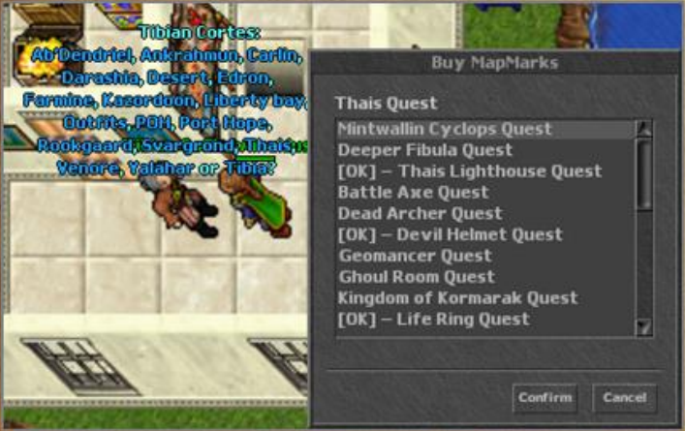
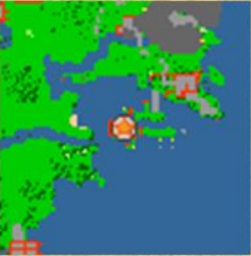
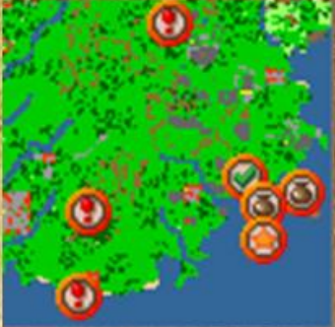
Tibian Cortes (NPC)
is the manager of the quest points
located east of thais
Buy Map Marks
NEW talk actions:
!quest // Give information about your quest points advance.
!marks + Quest // buy map marks wherever you are.
!archive // Give information about your achievements advance.
Marco Polo (Rook) and Tibian Cortes (Thais) will help you to monitor your progress and give the benefits.
for each quest you can buy map-marks for $100 to $500 gps.
Around 1400 Map-Marks.

Slide 7
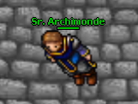
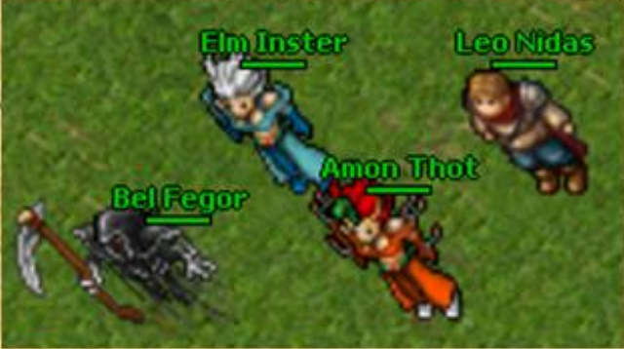
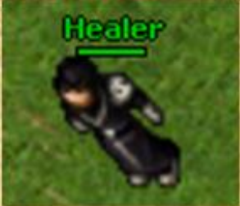
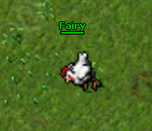
New summons

Slide 8
Experience system
Stages
+
Bonus Quest System
enabled 1
1 to 8 Exp * 1
9 to 20 Exp * 10
21 to 50 Exp * 8
51 to 100 Exp * 4
101 to 150 Exp * 2
151+ Exp * 1
if QuestPoints >= 280 then QuestRate = 300
elseif QuestPoints >= 260 then QuestRate = 250
elseif QuestPoints >= 240 then QuestRate = 200
elseif QuestPoints >= 220 then QuestRate = 150
elseif QuestPoints >= 180 then QuestRate = 100
elseif QuestPoints >= 140 then QuestRate = 80
elseif QuestPoints >= 100 then QuestRate = 50
elseif QuestPoints >= 70 then QuestRate = 20
elseif QuestPoints >= 40 then QuestRate = 10
elseif QuestPoints >= 20 then QuestRate = 5
elseif QuestPoints >= 5 then QuestRate = 2
else QuestRate = 1 end
exp = exp * QuestRate
XML\ stages.xml
events\scripts\player.lua

Slide 9
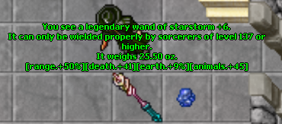
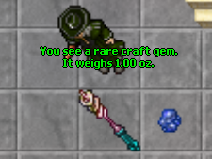
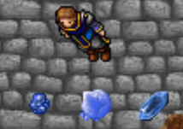


Rarity System
The craft gems you can loot form monster..
creaturescripts\scripts\others\Rairty.lua
Rare
+ you can get them by solving a quest.
+ some times the monster drop rarity items.
Epic
Surprise bags
Lerendary
Also when you kill monster you have probability to obtain surprise bag.
creaturescripts\scripts\others\surprise bag.lua
(The items you can get was improve)
Adapted by original mod:
[TFS 1.1] Ultimate item stat system uplouded by zbizu in Otland

Slide 10
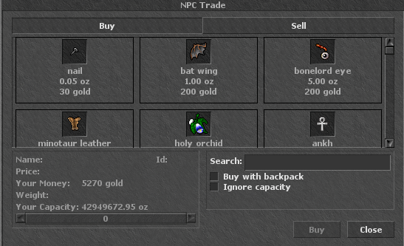

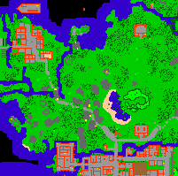

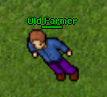
NPCs
Arround ~450
diferents
in all game
Some of them was added in strategic zone.
(Ex. Inquisition, POI, WOTE, etc.)
Sell runes
In game the NPC don’t sell runes.. (was disable)
Only in the city Pyre was add 1 NPC that sell runes (+90 Quest Points)
This with the intention of promoting runes maker.. so it not require soul to make runes.
2 Special NPC that buy and sell creature products.
1 NPC call Walmart include in the Hot Cuisine Quest.. that sell all kind of food.

Slide 11
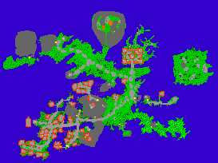
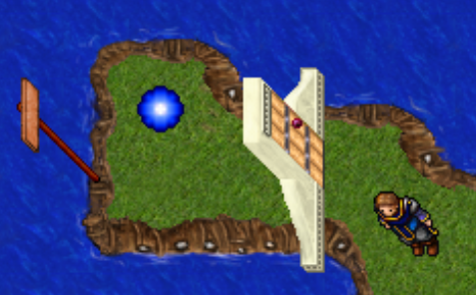
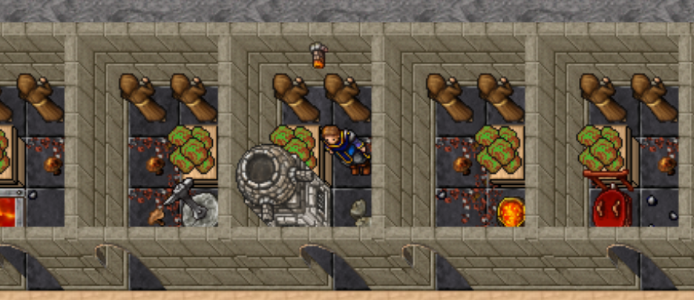
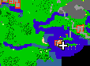
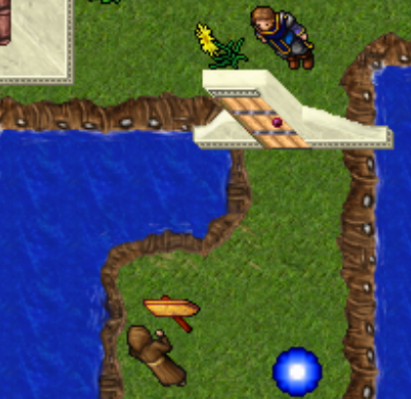
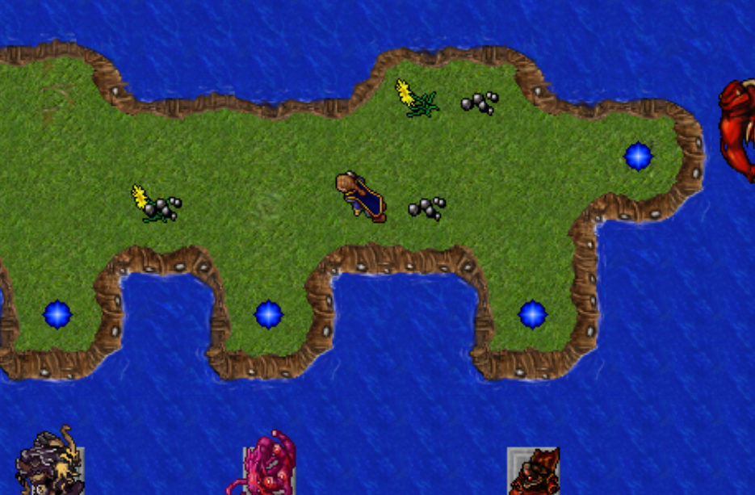
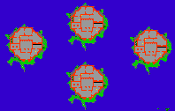
NEW Areas
Training monks
Pyre city
+ 90 Quest Points
+ 30 Quest Points
Castle of terror
4
+ 160 Quest Points
Like ferumbas castle
Whit 1 boss each one at the top.
Ferumbras
Morgaroth
Ghazbaran
Orshabaal
South east of thais

Slide 12
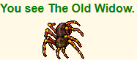
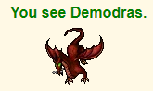
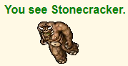
Bosses
Boss Leviathan
Boss The Noxious Spawn
Boss Necropharus
Boss The Horned Fox
Boss 4 Pirates
Boss The Snapper
Boss Hide
Boss The Bloodtusk
Boss Esmeralda
Boss The Old Widow
Boss The Many
Boss Stonecracker
Boss Tiquandas Revenge
Boss Demodras
Boss Fernfang
Boss Thul
Bosses do not spawn like normal creatures (spawn 1 hour), they are only found going through special teleports.
you don't need to complete the tasks of Grizzly Adams to face them.

